Slide 1
How To Broker Loans
Presented by:

Slide 2
Training Agenda
Introducing your FSB Team
Brokering Loans
Why FSB
Let’s Talk About Your Systems
Disclosing & Fees
Rates, Discounts, Credits & Lender Paid Comp
Processing Loans
Underwriting Loans
Closing Loans
FHA & VA Highlights
Final Thoughts

Slide 3
Meet Your FSB Team!
Your Account Executive –
Please see your Account Approval Letter to know who is your assigned Account Executive
Mortgage Support Team – Karley Stover – Team Manager
Mtg Support will be your go to for any questions, S/E income reviews, Pre-qual reviews, guideline questions and system questions. You name it, they can help with it!
Operations Manager – Josh Heinrich
On occasion, you may hear from our Ops Manager, Josh. He manages our Underwriters, and Closers.
Lock Desk Manager – Dave Weber
Dave oversees our Secondary Marketing Department and he or Mandy will be on the other end of any emails sent from the Lock Desk.
Becky Moorehead – Post Closing Department
Becky runs our Funding Team and the Post-Closing Department. If we our investors need anything after the closing, Becky’s team will be in contact with the Loan Officer.

Slide 4
Brokering Loans A Few Key Points to Remember!
Brokered loans close in the name of the Lender – Flanagan State Bank
1
Broker Compensation will either be Lender Paid Comp or Borrower Paid Comp – it cannot be both
2
All Title, HOI, Appraisal will be in the Lender’s Name!
3

Slide 5
A Few Important Questions…
We have a few things to ask you before we forget to make sure we understand how you are doing business currently.
What is your LOS system?
Does your LOS system allow for an export of a FNMA 3.4 file?
Do you currently sell loans on the secondary market?
Do you retain servicing on any loans?

Slide 6
Why FSB?
You’re gonna love working with us!
Quick Turn Times – turn times are always posted on our website www.fsbtpo.com
Competitive rates
A team dedicated to your business!
Training available when you need it
Easy to use LOS – Mortgagebot
Flanagan State Bank has been in business since 1913. We understand your business because you are what makes us who we are.
Quick chain of command to the top! If you need this, it is a short list to get to the Management Team
We do not market to YOUR customers! It is in our agreement, and we mean what we say. Any customers who call us in the future to do a loan are referred back to the institution they originated from.

Slide 7
Account Executive The addition to your team you always needed!
Our Account Executives are designed for the busy Loan Officer. All of our AE’s have many years of originating experience within the mortgage industry. They know what it is like to be a busy LO!
These are just some of what we help with! Let our AE’s be the missing link your team needed to provide the best service available to your customers.
Always available for a phone call! | Help with DU, LP or GUS errors & questions
Answer Mortgagebot questions | Answer scenario questions
Direct you to your assigned Underwriter | Help guide the loan submission process
Assist with rate lock, LE or data entry questions | Provide guidance on Processing requirements
Help to teach you status on files

Slide 8
Mortgage Support The addition to your team you always needed!
Mortgage Support was designed for the busy Loan Officer. Sure, we could have been like every other help desk offered by Lenders, but we wanted something more for the Loan Officers and staff that uses us. So…we gave them more! Mortgage Support will do all of these things and more!
These are just some of what we help with! Let us be the missing link your team needed to provide the best service available to your customers.
Answer Mortgagebot questions | Help with DU, LP or GUS errors & questions
Provide written prequals | Answer scenario questions
Prepare written S/E income analysis worksheets | Answer guideline questions for all programs
Direct you to your assigned Underwriter | Help guide the loan submission process
Assist with rate lock, LE or data entry questions | Provide guidance on Processing requirements
Help check status on files | Order Tax Transcripts on files, as needed
Offer training on multiple topics | Provide insight on underwriting requirements
Talk through a scenario or situation with Los | Prepare rental income worksheets
Look up the guidelines and send them to LO | Provide guidance on the VA Portal

Slide 9
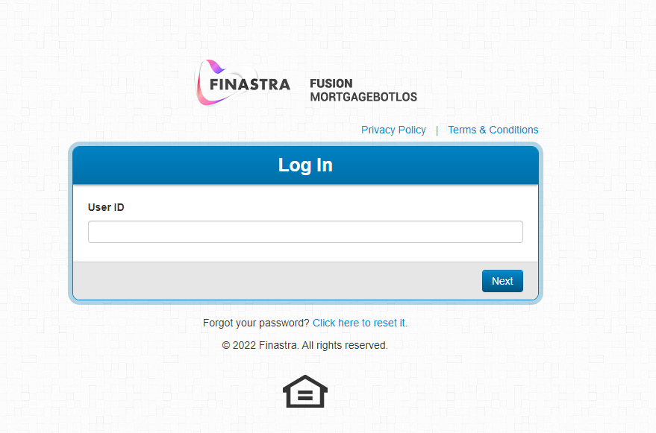
Let’s Talk LOS!
Mortgagebot is the LOS that FSB uses. Each user will receive a log in unique to the individual. These log in’s do expire approximately every 60 days due to security protocols.
Towards the end of this training, I will give you a tour of Mortgagebot so you can get started submitting loans!
As you learn our system, remember that you can always contact mtgsupportcenter@flanaganstatebank.com with any questions you may have.

Slide 10
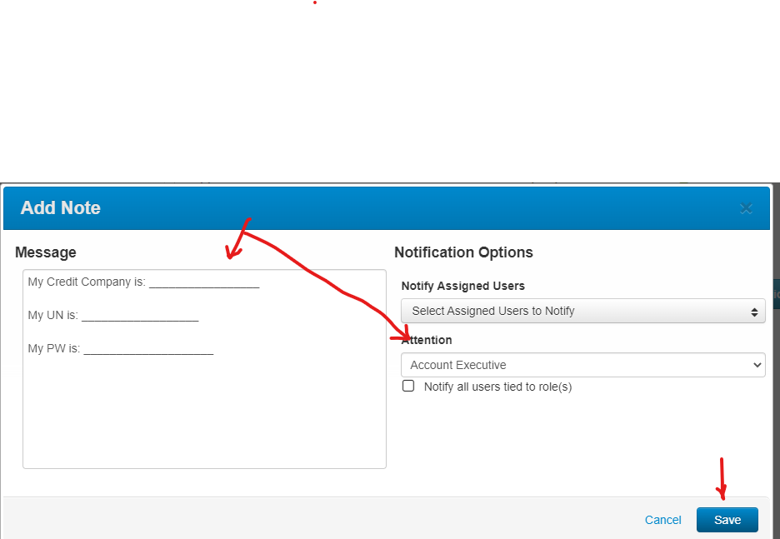
Starting a loan with FSB
Initial Loan Set Up Steps:
Step 1 – Start a file
There are 2 ways to start a file in Mortgagebot.
1) At the top of MortgageBot is a section that states Create a loan, here is a screen shot:
2) Upload a FNMA 3.4 file
This will include the URLA/1003 details only. LE fees and other file details that may be in your system will not be captured and will not be uploaded to our LOS.
3) Manual entry of the URLA
This will be a full manual entry of the data into our system. Estimated time for data entry is 10 – 20 minutes for the URLA data
4) FSB does not require any submission form in order to start your loan process. However, to assist you we will need to have your credit vendor login and password entered as a note into each loan. To add this note, please see the screen shots below. First click on the pencil in the top right had corner of each loan. Then add your information to the note pad, select Account Executive, and then hit save.
Please note that if you do not supply this information at time of starting a loan file, FSB will “re-pull” our own credit report at time of underwriting submission without contacting each broker.
Starting a loan within MortgageBot is very simple. Please see the steps on the right in order to have us take a look at a prequal, get a rate/price quote, run AUS, order an MI Certificate, send out initial disclosures to start the loan process, or submit your loan to underwriting. The information to the right is the first step, which is setting up each loan.

Slide 11
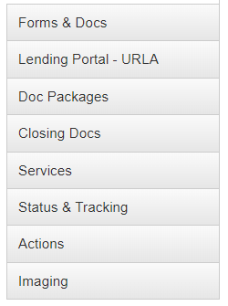
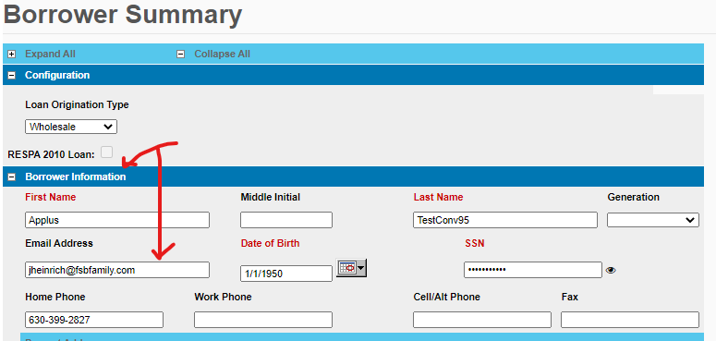
Starting a loan with FSB
Initial Loan Set Up Steps:
Step 1 – Start a file (Continued)
5) On the Left hand of each loan file within MortgageBot are the “Navigation Screens”. Here is a screen shot below of what this looks like within a loan file:
6) Under the “Forms & Docs” Button, please select the “Borrower Summary” Screen. It is very important that you fill out this entire screen in MortgageBot. This page advises FSB of some critical information that is not located on an URLA.
7) It is especially important to fill in each borrower(s) email address. This is the email we will use to communicate with the borrower(s) throughout the entirety of each loan in an “E-Sign” manner. If you leave this field blank, FSB will assume that the Broker will be working with the borrower(s) in a Wet-Sign Capacity. Please see a screen shot below of this page, and email field.
Please note that if you do not supply this information at time of starting a loan file, FSB will “re-pull” our own credit report at time of underwriting submission without contacting each broker.
Starting a loan within MortgageBot is very simple. Please see the additional steps on the right in order to complete the first step, Start a file.

Slide 12
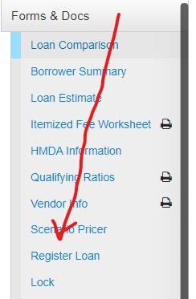
Starting a loan with FSB
Initial Loan Set Up Steps:
Step 2 – Register each loan
1) It is important for FSB to know when you start a new loan within our LOS. This will allow either your Account Executive, or our Mortgage Support Team to help you further.
2) Under Forms & Docs about midway down will be Register Loan. Once the screen comes up, double check all the data to make sure of accuracy. Pay special attention to:
Property Type
Occupancy Type
Make sure to enter the fico scores for each borrower
3) Here is a screen shot to assist you find our registration screen:
PLEASE NOTE – FSB, will disclose all loans within 72 hours to all borrowers when a property address is entered, and the loan is registered with FSB. FSB will contact each broker on the third day prior to automate disclosure to see if the broker would like to lock each loan. Any loan that has not been registered within 90 days will be automatically deleted within our system!
Starting a loan within MortgageBot is very simple. Please see the steps on the right for the second step, registering your loan. When you register each loan, it advises FSB that you have started your new loan automatically.

Slide 13
Starting a loan with FSB
Initial Loan Set Up Steps:
Step 3 – How to scenario price your loan or lock a new loan
1) Now it is time to introduce you to our web-site to help you further with critical processes you can perform when working with FSB. Our web-site address is www.fsbtpo.com . The main web-site page does not require a password to login.
2) We have a helpful tutorial to teach you how to scenario price or lock each loan. On the site, please follow this path:
Goto Mortgage Support Resources
Goto Document Library
Scroll down to our “How-To” section
See “How to Price out a Loan without Locking” (Insert Link later)
3) If you like the pricing / rate we are offering on your needed product you can lock your loan also by looking at our helpful tutorial also located on our web-site.
Goto Mortgage Support Resources
Goto Document Library
Scroll down to our “How-To” section
See “How to Lock your Loan” (Insert Link Later)
4) Please note that if you lock a loan, this will start our disclosure process.
5) For further details on understanding our pricing, please see the next two slides in this presentation.
Please see the steps on the right for the third step, scenario pricing your loan, or locking your loan. When you lock each loan, it will start our borrower disclosure process.

Slide 14
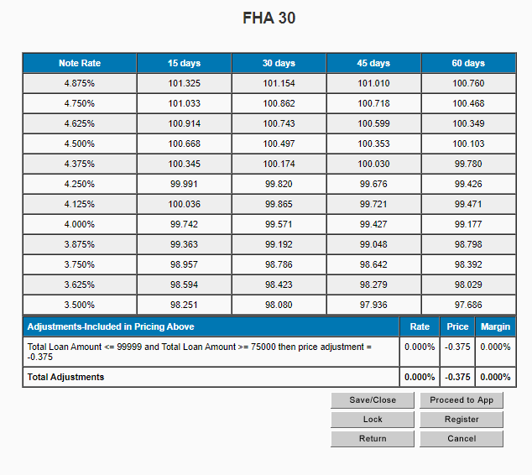
Disclosures & Fees
Discounts & Credits
Understanding when to charge a discount can be a little mind boggling to a Loan Officer. To help clarify, understanding the pricing engine you are working with is very important. FSB’s pricing engine is in Mortgagebot. In this example, the broker has a Lender Paid Comp plan of 2.0. The pricing will need to show as 102.00 for the comp plan to be met. The best pricing showing is 101.154 for a 30-day lock. The LO would subtract the pricing available from the comp plan they are trying to reach to calculate the discount points that will be charged. The difference is .846%. If the loan amount was 100,000 the discount would equate to 846.00. If the pricing is above the Lender Paid Comp Plan, any amount above the set plan (in this case 102) would be used as a credit to the borrower towards closing costs.
Once you lock a loan, FSB will complete all disclosures on brokered loans. Please note that you will not be able to edit our fees template prior to disclosure. These figures will be updated at a later date within our process with more accurate figures.
The fees that will be charged on a loan by FSB are:
$914 underwriting fee (this can be waived by adding an adjustment to the rate). Please see the below screen shot from our rate sheet on our UW Fee Waiver adjustment.

Slide 15
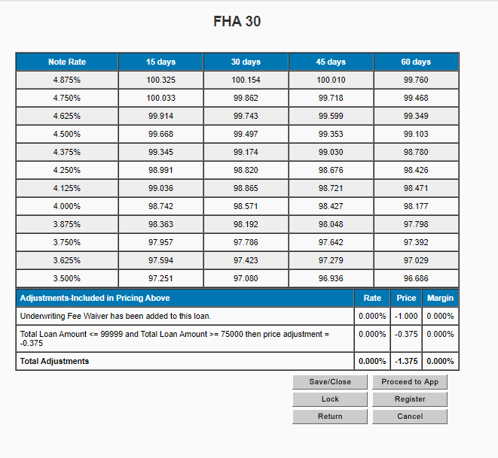
To waive the underwriting fee or not? The choice is yours! Higher loan amounts can accommodate for the fee in the APR/TRID test better than lower loan amounts. Using the Scenario Pricer will allow you to price the loan out either way!
Sample Pricing without UW Fee Waiver
Sample Pricing with UW Fee Waiver

Slide 16
Starting a loan with FSB
Initial Loan Set Up Steps:
Step 4 – How to run a loan through our Automated Underwriting System
1) Please note that FSB will always run GUS (Guaranteed Underwriting System) on all USDA loans at time of underwriting submission.
2) FSB allows either LP or DU submissions on all Brokered Conventional loans. FSB requires the use of DU on all FHA and VA loan submissions.
3) Please remember, that accurate ratio assessment is important to AUS findings, and therefore we encourage our brokers to run an MI Quote on all Conventional loan submissions. We have a helpful tutorial to teach you how to run an MI Quote.
Goto Mortgage Support Resources
Goto Document Library
Scroll down to our “Mortgage Bot and Support” section
See “How to use Mortgagebot for PMI Quote” (Insert Link later)
4) Though, we do not require Brokers to run an AUS prior to underwriting submission, we highly encourage the practice. We have a helpful tutorial to teach you how to run either AUS within Mortgage Bot.
Goto Mortgage Support Resources
Goto Document Library
Scroll down to our “How-To” section
See “How to Run AUS-DU/LP” (Insert Link later)
5) For further help running an AUS or problem solving, please contact either Mortgage Support or your assigned Account Executive.
Please see the steps on the right for the fourth step, running your loan through Automated Underwriting Systems.

Slide 17
Starting a loan with FSB
Initial Loan Set Up Steps:
Step 5 – FSB Broker Disclosure Process
1) FSB, will disclose all loans within 72 hours to all borrower(s) when a property address is entered, and the loan is registered.
2) FSB will disclose all locked loans within 24 hours to all borrower(s).
3) FSB will contact each broker on the third day prior to our automatic disclosure to see if the broker would like to lock each loan or WD their request.
4) Please make sure at the time of creating each loan, that you enter all borrower email addresses on the borrower summary screen within MBOT. If an email address is NOT located within MortgageBot at the time of disclosure, we will assume that you are having the borrower(s) wet-sign disclosures.
5) FSB will disclose at time initial Loan Estimate, standardized Broker fees.
6) If the broker has not ordered an MI Quote on a conventional loan by the third business day after registration, FSB will order each quote with a MI provider of our choosing for the disclosure process.
As a reminder, we have a helpful tutorial on our www.fsbtpo.com web-site to teach you how to run an MI Quote within MortgageBot.
Goto Mortgage Support Resources
Goto Document Library
Scroll down to our “Mortgage Bot and Support” section
See “How to use Mortgagebot for PMI Quote” (Insert Link later)
PLEASE NOTE THAT EACH BORROWER(S) WILL RECEIVE TWO DISCLOSURE PACKETS WITHIN 72/24 HOURS. THE FIRST PACKET WILL CONTAIN OUR STANDARD DISCLOSURES. THE SECOND PACKAGE WILL CONTAIN OTHER REQUIRED LENDER DOCUMENTS. FSB WILL REQUIRE SIGNATURE ON ALL DOCUMENTS PRIOR TO EACH LOAN BEING SUBMITTED TO UNDERWRITING.
Please see the steps on the right for the fifth step, the FSB Disclosure Process.

Slide 18
Starting a loan with FSB
Initial Loan Set Up Steps:
Step 6 – FSB Broker Appraisal and Case Number Order Process
Prior to Appraisal Orders
1) With an approved roster of 3 - 5 local appraisers, we can order your appraisals directly through our Appraisal Department instead of an AMC Service. We do not charge any additional fees for this service to be used. The appraisers are happy because they get to retain their full fee for the service.
2) To get your roster setup up for FSB to use, simply email a completed Appraisal Roster Request to appraisal@flanaganstatebank.com. The request should list the names, addresses, email, phone numbers, and the counties covered of each appraiser you wish to add to our roster. Once approved, you will receive a notification that your roster is setup for use in combination with loans you broker to FSB. We ask that you please CC your assigned Account Executive when requesting appraisal roster additions.
Appraisal Order Process
1) Please note that the Broker must start the appraisal ordering process on all Wet-Sign loans. To start this process, please return the signed Wet-Signed Disclosure packages along with our Appraisal Payment form to mtgsupportcenter@flanaganstatebank.com . Once received, our team will order the appraisal for each loan.
2) FSB will automatically receive all E-Signed Disclosures packages once signed by the borrower(s) and Brokers loan officer. When we receive these disclosures, our team will send an email to the loan officer asking for them to complete our Appraisal Payment form. Once we receive the form back, our team will order the appraisal for each loan.
3) Each Broker client can make the decision to NOT have an appraisal ordered at the time we receive disclosures back from borrower(s). When our team emails you, please advise that you would like to have your loan underwritten prior to ordering an appraisal.
4) At any time during the process, after disclosures are signed you may request an appraisal to be ordered. To start this process, please email our Appraisal Payment form to mtgsupportcenter@flanaganstatebank.com . Once received, our team will order the appraisal for each loan.
PLEASE NOTE THAT BROKERS WILL NEVER HAVE TO UPLOAD AN APPRAISAL TO OUR IMAGE FLOW SYSTEM. FSB WILL ALWAYS UPLOAD THE APPRAISA, UNLESS THE APPRAISAL IS A TRANSFERRED CASE.
IN ADDITION, FSB WILL ALWAYS ORDER FHA AND VA CASE NUMBERS AT THE TIME OF APPRAISAL ORDERING ON GOVERNMENT LOANS! FOR APPRAISAL TRANSFER OR CASE NUMBER TRANSFER REQUESTS PLEASE SEE FURTHER INSTRUCTIONS IN THIS PRESENTATION.
Please see the steps on the right for the sixth step, the Appraisal Order Process.

Slide 19
Processing Government Loans
Government loans on the Secondary Market are full of documentation requirements! FSB does its very best to limit the documentation when we are able, but these loans by nature require more documentation than a conventional loan and substantially more than a portfolio loan. To help you navigate the requirements, we strongly recommend sending files over for Prequal! The Prequal will be written out to help you know what our underwriting will be looking for in terms of documentation based on the URLA, Credit and AUS Findings.
Here is a list of very standard requirements from underwriting to help you get a feel for what we will need:
Document | All Loans | FHA | VA | USDA | Conventional
Copy of Driver’s License – all borrowers | X
2 years W-2’s/1099’s – all borrowers |  | X | X | X | Follow AUS
2 years Personal Tax returns and business returns if self employed or received income only shown on the returns | X |  |  |  | Follow AUS May only need 1 year
2-month bank statements or asset statements (any assets on the URLA will need documentation) and sourcing of large deposits w/LOX | X |  |  |  | Follow AUS
30 days of paystubs – all borrowers |  | X | X | X | Follow AUS
Written VOE – 2-year history |  | X | X | X | Follow AUS
Title Commitment with wire instructions, CPL, 24-month chain of title, EPA & Comp endorsements & preliminary CD showing title fees & credits | X
HOI Dec Page or Binder with FSB Mortgagee Clause and dwelling coverage to cover loan amount | X
VOR required |  | Under 660 or compensating factor or Refer/Eligible | Refer/Eligible | Refer/Eligible | Follow AUS
LOX for Derogatory Credit |  | X | X | X | X
If Refinance: current statement, tax bill, HOI and payoff | X

Slide 20
Processing Tips
A sample of other documentation that may be needed:
Divorce Decree
Proof of 6 months receipt of child support
Proof of continuance of child support if decree does not provide DOB for children
Proof of satisfaction/release of judgment
Liquidation of retirement account for down payment
Gift documentation – gift letter, donor bank statements, proof of deposited funds
Sourcing of large deposits – copy of item deposited and LOX to explain what it is
Bankruptcy papers – all schedules plus discharge (CH7 & CH13)
Rent Free Letter
Retained Home – tax bill, HOI dec page & lease with proof of security deposit or first month’s rent
Rental Homes – tax bill, HOI dec page, current lease, mortgage statements and 2 years tax returns
LOX for overdrafts or NSF’s on a bank statement
This list is not all inclusive and is provided to help the Loan Officer or Processor understand the documentation needed for underwriting a Government loan.
Government Loans have a lot of flexibility in their guidelines. Due to this, the documentation needed for a loan will vary from loan to loan. Although the standard list will be applicable, there are many situations that will require their own set of documentation. An example of this will be a Bankruptcy or Divorce. Bankruptcy paperwork will always be needed and if the BK was a CH 7 and included a home, the sheriff’s deed for the foreclosure will be needed, as well.
As you get to know us, the Prequal Service we offer with our Mtg Support Team will help you get used to the documentation we are looking for. Please understand that the PQ is reviewed on limited information! And, as thorough as we are, other information is presented at time of Underwriting that the Mtg Support team may not have been aware of and the conditions from underwriting will reflect this new information.

Slide 21
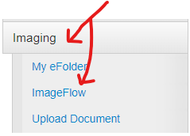
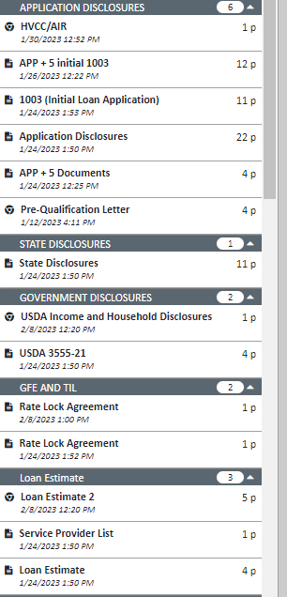
Starting a loan with FSB
Initial Loan Set Up Steps:
Step 7 – FSB Broker Underwriting Submission Process.
Prior to Underwriting Submission
1) Note that you may contact each underwriter directly via email, or when necessary, by phone during the underwriting process.
2) For this process, it is necessary to teach you how to view documents within our E-Folder, referred to as “Image Flow”, within MortgageBot. From the Navigation Panel in MortgageBot select:
Imaging
Image Flow
C) Once the disclosures have been received you will see those disclosures within “Image Flow”. Here is a screen shot of what you will see. If you do not see these documents, then FSB has not received disclosures back yet from the borrower(s).
Please see the steps on the right for the seventh step, Underwriting Submission Process.

Slide 22
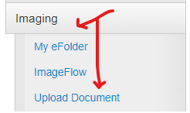
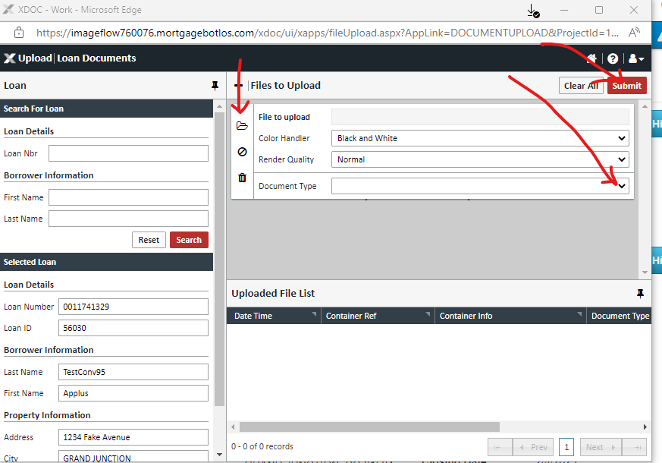
Starting a loan with FSB
Initial Loan Set Up Steps:
Step 7 – FSB Broker Underwriting Submission Process. (Continued)
Underwriting Submission
1) Once you have verified your disclosures are back to FSB you can submit your loan to our underwriting department.
2) Please upload your entire processing file into Image flow. From the Navigation Panel in MortgageBot select:
Imaging
Upload Document
C) Then select the “Folder” icon in the top left-hand corner and you will see your PDF file in that section. Then hit the drop-down arrow under “Document Type”.
Please see the steps on the right for the seventh step, Underwriting Submission Process (continued).

Slide 23
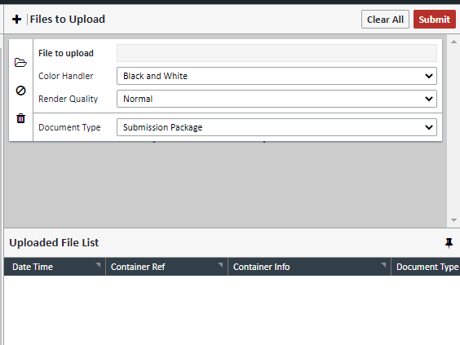
Starting a loan with FSB
Initial Loan Set Up Steps:
Step 7 – FSB Broker Underwriting Submission Process. (Continued)
Underwriting Submission (Continued)
D) Under the “Document Type” arrow drop-down you will see “Submission Package”, then hit the “Submit” button in the top right-hand side. Please see the screen shot below:
Further Notes about Uploading Documents:
1) You will notice that “Submission Package” always is at the top of the drop-down. FSB does NOT want Brokers to select any other label when submitting new Broker files to be underwritten. Our internal staff will use the additional labels after you submit each loan.
2) Please make sure that your submission package fully uploaded to Image Flow. Sometimes you may have to upload numerous “Submission Packages” on each loan depending upon the size of your PDF documents.
3) Make sure that your submission includes the proper credit report that you are using on each loan submission.
NOTE – YOU ARE NOT YET DONE WITH THIS WORKFLOW CONTINUE TO THE NEXT PAGE IN THIS PRESENTATION.
Please see the steps on the right for the seventh step, Underwriting Submission Process (continued).

Slide 24
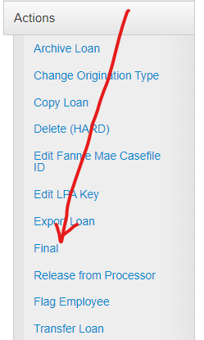
Starting a loan with FSB
Initial Loan Set Up Steps:
Step 7 – FSB Broker Underwriting Submission Process. (Continued)
Underwriting Submission (Continued)
E) Once your submission package(s) are uploaded, it is time to submit your loan to underwriting. Under the Navigation Panel, go-to “Actions”, then select “Final”. Each time you submit to our underwriting department, you must repeat this process. Please see a screen shot of what you will see:
Final FSB Internal Steps Prior to Underwriting Submission:
1) After you “Final” each loan submission our internal team will order a flood certificate and upload to Image Flow, Upload MI Cert (I/A), Run AUS if you did not do so prior (always run GUS on USDA loans), and order tax transcripts (I/A) for each loan. Due to this, each loan will move to our underwriting department within 2 hours of you “Finaling” each loan.
2) FSB’s internal team may contact you at this stage if we have any significant concerns or need further data to run an AUS, if the broker did not do that prior.
Please see the steps on the right for the seventh step, Underwriting Submission Process (continued).
1) After you “Final” each loan submission our internal team will order a flood certificate and upload to Image Flow, Upload MI Cert (I/A), Run AUS if you did not do so prior (always run GUS on USDA loans), and order tax transcripts (I/A) for each loan. Due to this, each loan will move to our underwriting department within 2 hours of you “Finaling” each loan.
2) FSB’s internal team may contact you at this stage if we have any significant concerns or need further data to run an AUS, if the broker did not do that prior.

Slide 25
Starting a loan with FSB
Initial Loan Set Up Steps:
Step 8 – Understanding our FSB Approval and Broker Underwriting Resubmission Process.
Understanding our FSB Approval
1) We have a helpful tutorial to teach you how to view each Underwriting Approval Notice.
Goto Mortgage Support Resources
Goto Document Library
Scroll down to our “Mortgage Bot and Support” section
See “How to view the Conditional Approval” (Insert Link later)
Resubmitting Conditions to Underwriting
1) We have a helpful tutorial to teach you how to upload your conditions to MortgageBot.
Goto Mortgage Support Resources
Goto Document Library
Scroll down to our “How-To” section
See “How to Upload Conditions (The Easy Way)” (Insert Link later)
2) DO NOT FORGET TO “FINAL” YOUR LOAN AGAIN. SEE THE SAME STEPS UNDER THE FSB BROKER UNDERWRITING SUBMISSION PROCESS IN THIS PRESENTATION.
Please see the steps on the right for the eight step, Understanding our Underwriting Approval form, and Underwriting Re-Submission Process.

Slide 26
Starting a loan with FSB
Initial Loan Set Up Steps:
Step 8 – Understanding our FSB Approval and Broker Underwriting Resubmission Process. (Continued)
Underwriting Resubmission Process – ICD Request
3) FSB does not require any type of form to prepare an ICD to send out to borrower(s), however, you must upload a preliminary (prelim) CD into your final resubmission to underwriting for FSB to properly prepare an ICD.
4) Though we do not require an ICD request form to be uploaded into MortgageBot for ICD creation, you may upload one instead of proceeding to the next step in this work-flow. The form should be uploaded to Image Flow as “Early Closing Disclosure Request Form”. In order to procure this form please goto:
Goto Mortgage Support Resources
Goto Document Library
Scroll down to our “How-To” section
See “Early Closing Disclosure Request Form” (Insert Link later)
5) If you do not want to upload our form, you may instead simply add notes in MortgageBot with information that is required to prepare an ICD. Those notes must state:
“Please issue an ICD”
B) Provide all Real-Estate Agents State ID’s, Company Name (Brokerage Firm), Company State ID’s, and contact information.
C) Are there any “Non-Borrowers” taking a title position.
D) Will there be a homestead waiver required at closing.
E) Is there a different amount of tax escrow you want collected vs. the qualification tax amounts being used. If that answer is yes, why the difference?
To add these notes, please see the screen shots on the left. First click on the pencil in the top right had corner of each loan. Then add your information to the note pad, select Account Executive, and then hit save.
Please note that if you do not supply this information at time of requesting an ICD, FSB will email each broker to provide this information.
Our FSB internal team will email each loan officer to review each ICD prior to having it emailed directly to the borrower(s) for signature.
Please see the steps on the right for the eight step, Understanding our Underwriting Approval form, and Underwriting Re-Submission Process. (Continued)

Slide 27
Starting a loan with FSB
Initial Loan Set Up Steps:
Step 8 – Understanding our FSB Approval and Broker Underwriting Resubmission Process. (Continued)
Resubmission (Continued) / Receiving Underwriting Cleared to Close
1) After each ICD has been sent to the borrower(s), our internal team will resubmit each loan to our underwriting department. If file is a Conventional Loan needing PMI or a USDA loan, allow for extra time to underwrite.
2) Please note that all Conventional loans with MI, and USDA loans will “move” from underwriting to a “UW Pre-Approved” status within MortgageBot after our underwriting department has moved the loan to either an MI provider, or USDA. If you would like to understand all of our different statuses, please see www.fsbtpo.com for a listing.
3) Turn times for underwriting can be found at www.fsbtpo.com
4) Note that you may contact each underwriter directly via email, or when necessary, by phone during the underwriting process.
5) After your loan is Cleared to Close, you will receive an email directly from the Underwriter stating the following:
Congratulations! I have cleared to close this file. Attached please find the final approval. If you are a correspondent customer, you may proceed on the closing of your loan. If you are a broker and your loan is a “Wet-Signed Submission”, please make sure to upload into MortgageBot your Signed ICD. Our Internal Mortgage Support Team will be emailing you shortly to setup and schedule your closing!
As helpful reminders, please make sure to review any conditions labeled as “PTF” on each approval. These are items that will be required prior to the funding of each loan and listed as conditions to each title company. If you are a Broker customer, please be prepared to provide the following information to our Mortgage Support Team to start your closing process: Title Company Closing Contact, Will there be a mail –away, Closing Date and Time, and will there be any Power of Attorney forms required? Thank you!
Our FSB Mortgage Support team will be reaching out to each Broker Client within 4 hours of each Cleared to Close email being sent from our underwriting department!
Please see the steps on the right for the eight step, Understanding our Underwriting Approval form, and Underwriting Re-Submission Process. (Continued)

Slide 28
Starting a loan with FSB
Initial Loan Set Up Steps:
Step 9 – Closing each loan
1) Now that your loan is Cleared to Close, our Mortgage Support Team will be contacting you via email to provide the following information:
Note – In our contact email, we will provide you with a closing request form to fill out or you simply can email back the below information to our email request.
Title Company Closing Contact?
Will there be a mail away required for this closing?
Closing Date and Time?
Will there be any Power of Attorney forms required for either the borrower(s) or seller(s)?
2) Once we have the Closing Date and Time, our internal team will review your provided HOI for proper effective date, and the lock on each loan to make sure it will not expire prior to the funding date of the loan. We will contact you directly for this information, if necessary, prior to confirming your closing date. You will receive an email with confirmation that your closing has been scheduled with our closing department.
3) Please note that we require at least a 24-hour notice to provide a closing package with a cut-off time of 12 PM CST each day. You may also see our closing calendar which will reference any days that FSB is closed due to holidays. Closing Calendar can be found at www.fsbtpo.com
4) After your loan has been confirmed to close, our closing department will start the communication between Title, FSB and include Broker in an email within 24 hours of your closing date and time. Please always reply all to keep the email chain going and the communication continuous. At the end of this process, our assigned Closer will state “Do all Parties Agree with Figures”. The Broker will need to “reply all” to bless each final figure before we send out the closing package to the title company.
Again, we remind you to please make sure to review any conditions labeled as “PTF” on each final underwriting approval. These are items that will be required prior to the funding of each loan and listed as conditions to each title company.
Please see the steps on the right for the ninth step, Closing the loan.

Slide 29
Starting a loan with FSB
Initial Loan Set Up Steps:
Step 10 – Funding each loan
1) FSB will send the wire to title the day of the closing or, if an early closing, the day before
2) FSB uses a Funding Authorization process. We have specific documents we will request each and every time to be sent to our Funding Department for review before we authorize the loan to fund. This will take 15 – 30 minutes, depending on volume. Please see www.fsbtpo.com for a funding authorization checklist if you want to see what we require from each title company prior to authorizing funding.
3) Please note that our funding authorization checklist does NOT include any required “PTF Underwriting” approval conditions that must also be sent to title for funding authorization.
4) If you would like to have an underwriting notice updated prior to the date of your closing on PTF conditions, simply upload those to “Prior to Funding Condition” and email fundings@flanaganstatebank.com and we will update each approval as soon as possible.
5) After the loan is closed the Title Company will send the closing docs, per our instructions, directly back to us. We will scan the package and add it to the file in Image flow. Brokers will always have access to the file.
Please see the steps on the right for the tenth step, Funding the loan.

Slide 30
Additional Possible Work- Flows
Initial Loan Set Up Steps:
Additional Loan Work-Flows
Transferring an FHA Appraisal / Case Number
1) From time to time you may need to have an FHA Appraisal and Case number transferred to FSB. In order to do so, you must fill out our FHA Case Number Request/Transfer Form. It is located at www.fsbtpo.com website.
2) There is an email address on the form, govrequests@flanaganstatebank.com where the completed form must be emailed to.
3) Within 24 hours, our team will advise you that the transfer is complete. The case number will be uploaded to our Image Flow for you.
4) In situations when you are transferring an appraisal to FSB, the Broker must upload the appraisal (in color – make sure to click this box when uploading) in Image Flow. Please label this as a “Prior to Closing Condition”.
Sometimes, you may require other help within the loan process. Those include, transferring an FHA appraisal /case number, appraisal appeal process, redisclosing a loan prior to an ICD request or requesting a product change, Ordering a Certificate of Eligibility for a VA loan, and how to present an escrow repair holdback to underwriting. Please see these additional slides for each work-flow. The steps for first one, transferring an FHA Appraisal / Case Number is to the right.

Slide 31
Additional Possible Work- Flows
Initial Loan Set Up Steps:
Additional Loan Work-Flows
Appraisal Appeal Process
1) You may elect to have an appraised value appealed sometimes, though it is rare that values usually increase. If you want to appeal a value, please fill out our appropriate form from www.fsbtpo.com .
2) Please follow the instructions on the form.
3) After you have the form complete, please send the completed form back to appraisal@flanaganstatebank.com
4) Within 24 hours, our team will send the new information for the appeal to the appraiser.
5) Once the appraiser has made their determination, we will advise you of that decision.
Sometimes, you may require other help within the loan process. Here is our second additional work-flow, appraisal appeal process.

Slide 32
Additional Possible Work- Flows
Initial Loan Set Up Steps:
Additional Loan Work-Flows
Requesting a Re-Disclosure prior to an ICD Request
NOTE – IF YOU ORIGINALLY HAD A LOAN DISCLOSED WITHOUT THE FILE BEING LOCKED, ONCE YOUR LOAN IS LOCKED, FSB WILL ALWAYS SEND OUT REDISCLOSURES TO THE BORROWER(S). THERE IS NO NEED FOR YOU TO REQUEST A RE-DISCLOSURE IN THIS SITUATION. OUR TEAM WILL SEND YOU A COPY OF THE RE-DISCLOSURE PRIOR TO SENDING OUT TO ALL BORROWER(S) FOR YOUR BLESSING BEFORE IT IS SENT.
Please note that if you ever start a loan as a correspondent and need to change a loan to an FHA product, we will not be able to re-disclose. Unfortunately, the loan must be denied, and the loan will need to be restarted as a brokered loan.
Please also know that if you start a brokered loan as a lender paid loan, you may not elect to change that loan to a borrower paid loan later.
1) Sometimes, you may need to request a re-disclosure during the loan process for a particular fee, or product change.
2) Please remember that timing of re-disclosure is important. We can re-disclose many times on an ICD rather than re-disclosing prior to that stage of the loan process. Our internal team may reach out to you in circumstances of re-disclosure request when FSB feels the timing of the request may be better served by issuing an ICD.
3) To request a re-disclosure or product change the loan officer must complete our re-disclosure form. You can find this form at www.fsbtpo.com . In addition, please allow 24 hours in these situations.
4) Once the form is completed, please send the completed form to tpodisclosures@flanaganstatebank.com .
5) Our Internal team will then re-disclose each request within 24 hours of receipt. We may contact the loan officer if we have questions prior to re-disclosure creation.
OUR TEAM WILL SEND YOU A COPY OF THE RE-DISCLOSURE PRIOR TO SENDING OUT TO ALL BORROWER(S) FOR YOUR BLESSING BEFORE IT IS SENT.
Sometimes, you may require other help within the loan process. Here is our third additional work-flow, requesting a re-disclosure / product change prior to an ICD request.

Slide 33
Additional Possible Work- Flows
Initial Loan Set Up Steps:
Additional Loan Work-Flows
Requesting a COE on a VA Loan
1) Many times, before originating a VA loan, the loan officer may want to make sure that a Veteran or Reservist is eligible for VA financing. If you would like FSB to check that eligibility, please follow the process below.
2) Please send an email to mtgsupportcenter@flanaganstatebank.com with the following information:
Header of the email should state, “Please Order COE for VA Loan”
Email must include Veteran SSN, and Date of Birth.
3) Our internal team will order a COE within 4 hours of each request.
4) Please know that sometimes the department of Veteran Affairs may require additional information that can only be obtained on the Veterans “DD214” . In these instances, our team will reach out to the loan officer requesting this form.
Sometimes, you may require other help within the loan process. Here is our fourth additional work-flow, requesting a Certificate of Eligibility for a VA loan .

Slide 34
Additional Possible Work- Flows
Initial Loan Set Up Steps:
Additional Loan Work-Flows
Establishing an Escrow Repair when required
NOTE – FSB ALLOWS FOR ESCROW REPAIRS TO HAVE PROPERTIES MEET HUD, FNMA, OR FREDDIE MAC GUIDELINES. HERE ARE OUR POLICIES FOR ESCROW REPAIRS BELOW
Who can do the Repair work?
➢ Repairs cannot be completed by the borrower – no exceptions
➢ Repairs can only be completed by a licensed contractor or if state does not require licensing, contractor must be verifiable and have valid insurance.
Allowed Repairs for Escrow:
➢Escrow repair items can ONLY be used for repair items that bring the subject property to product guidelines.
Non-Allowed Escrow Repair Items:
➢Repairs that are structural in nature, or
➢Repairs that affect the safety or soundness of the property, or
➢Repairs that are cosmetic in nature are not allowed.
Example, borrower wants newer cabinets. Allowed Amount of Escrow: ➢No Maximum amount, but the escrow repair can ONLY be used for repair items that bring the subject property to product guidelines. No structural or “cosmetic” repairs can be done.
➢If the amount of the escrow will be less than $7,500 total then the lock duration must cover the loan funding date.
➢FHA loans, Conventional Purchases, and VA loans do not allow the repair amounts to be included in the loan amount. In some circumstances repairs may be financed into a USDA loan.
Required Contingency:
➢For Borrower funded escrows 150% of the highest bid will be held, for Seller funded escrows 100% of the highest bid will be held. *Note that all excess amounts of overfunded borrower funded escrows will be principally applied to their loan.
Sometimes, you may require other help within the loan process. Here is our fifth additional work-flow, establishing an escrow repair when required.

Slide 35
Additional Possible Work- Flows
Initial Loan Set Up Steps:
Additional Loan Work-Flows
Establishing an Escrow Repair when required (Continued)
Work Bid Requirements:
➢Requires 2 bids for all repairs
➢Must include the contractor’s name and contact number.
➢FSB will utilize the higher of the 2 bids for calculation of the holdback amount.
➢If bids are greater than 20% different from each other, an itemized bid will be required from the highest bid for further examination. If the amount provided on the bids do not appear to be sufficient for the work required a cost to cure will be requested from the appraiser to determine the amount held.
➢If a seller funded escrow, the Bids must be signed by both the buyer(s) and seller(s).
➢If a borrower funded escrow, the Bids must be signed only by the buyer(s).
Time Frame Allowed and Lock Policy:
➢If the amount of the escrow will be greater than $7,500 total then the lock duration must cover the time frame required on a post-closing basis for all repairs to be completed and a final inspection to be completed.
➢FSB only offers a maximum of a 60-day lock duration, therefore if you require more time for any reason (delay due to materials or weather delay) then 30 BPS (.30) must be charged for every additional 15 days greater than 60 days to the borrower. This can be a seller concession.
Example 1: • A septic system needs to be replaced for the property • The highest bid is for $10,000 and will be seller funded. • The escrow will be for $10,000 at time of closing • Loan is closing January 1st • The repair cannot be completed until April 1st, , or 90 days from closing • Loan officer has 15 days remaining on a 60 day lock at time of closing. • The borrower will need to be charged 90 BPS because they require an additional 45 days from the initial lock period.
Example 2: • Two windows need to be replaced for the property • The highest bid is for $3,500 and will be borrower funded. • The escrow will be for $5,250 at time of closing (150% of the highest Bid) • Please remember to consider these funds into your cash to close required. • Loan is closing January 1st • The repair cannot be completed until April 1st, , or 90 days from closing. • There is no fee required to be charged to the borrower.
Sometimes, you may require other help within the loan process. Here is our fifth additional work-flow, establishing an escrow repair when required. (Continued)

Slide 36
Additional Possible Work- Flows
Initial Loan Set Up Steps:
Additional Loan Work-Flows
Establishing an Escrow Repair when required (Continued)
Escrow Agreement:
➢For Seller funded Escrows, the FSB Escrow repair holdback agreement must be presented to underwriting with both the seller(s) and buyer(s) information on the documents, unsigned. We will require all parties to sign at time of funding, if not previously executed. An updated form is available on our www.fsbtpo.com website. Please see the correct form labeled Seller Funded Escrow Repair Agreement.
➢For Borrower funded Escrows, the FSB Escrow repair holdback agreement must be presented to underwriting with the buyer(s) information on the document, unsigned. We will require all buyer(s) to sign at time of funding, if not previously executed. An updated form is available on our www.fsbtpo.com website. Please see the correct form labeled Buyer Funded Escrow Repair Agreement. Requesting Escrow
Disbursement after closing:
➢ A Final Inspection and final invoices are to be sent to rebeccamoorehead@flanaganstatebank.com for approval to release funds. In order to have a final inspection ordered prior to your request, simply email appraisal@flanaganstatebank.com once you confirm all repairs are completed.
➢ Please allow 5 business days to request and then receive payment. .*Note that all excess amounts of overfunded borrower funded escrows will be principally applied to their loan.
Sometimes, you may require other help within the loan process. Here is our fifth additional work-flow, establishing an escrow repair when required. (Continued)

Slide 37
Mortgagebot Demo
At this time, your Trainer will take you to a live review of the Mortgagebot LOS

Slide 38
Program Highlights
The Basics of USDA, FHA & VA Loans

Slide 39
Government Loan Disclaimer
This training is designed to give you an overview of the FHA, USDA and VA programs. It is to be used to provide guidance and basic information to allow the viewer to understand the flexibility these programs provide. It is not possible to cover all scenarios that these programs have the potential to do. For specific advice on a situation, please contact mtgsupportcenter@flanaganstatebank.com

Slide 40
FHA Basics

Slide 41
FHA – the most flexible underwriting on the market!
Pros
Cons
Minimum 600 credit score
Dinged up credit is acceptable
96.5% LTV for a purchase
97.75% LTV for refinance
Lower rates than conventional
MI is equal to or sometimes lower than PMI
Payment is equal to or lower than conventional
Up to 55% DTI allowed with A/E AUS
Non-Occupant Borrowers are allowed
No cash out adjustment
Combining a 1st and 2nd mortgage is not considered cash out! Unless the 2nd mortgage was used to pull cash out of the property within the most recent 12 months.
Manual underwriting allowed
MI on a 30-year loan with max LTV will remain on for the life of the loan
If LTV is under 90%, MI will be in place for 11 years
UFMIP and Monthly MI are required – each and every time the FHA program is used
FHA has loan limits – these are by county and can be checked at https://entp.hud.gov/idapp/html/hicostlook.cfm
Only 1 FHA loan per family – there are a couple of exceptions to this rule
Minimum Property Requirements (could be seen as a Pro, too)
UFMIP – Up Front Mortgage Insurance Premium is 1.75%
Monthly MI is .55

Slide 42
FHA & Credit
Credit Requirements
600 Minimum Credit Score
BK for CH 7 must be 2 years old
BK for CH 13 – can be currently in a BK or discharged for at least 12 months.
Housing payments – If Approve/Eligible received from DU, credit is accepted. If Refer/Eligible no more housing lates are allowed.
Negative credit within the most recent 12 months is not acceptable, unless extenuating circumstances and dependent on what the negative credit is
Foreclosure, short sale or deed in lieu must be 3 years past Sheriff’s Deed date
No open judgments allowed
Medical Collections can be disregarded for DTI purposes, but LOX for collections will still be needed
LOX always needed for all derogatory credit on the credit report
600 – 659 score range has additional Overlays specific to FSB
FHA is very flexible with the credit criteria. The LO & Processor’s role with a file is to maximize the strengths of the file and minimize the weaknesses.
This starts with making sure the Underwriter has a clear picture of the entire file. The use of notes to the underwriter to explain the details they might not see or will have further questions about will go a long way to helping gain an approval and keeping conditions low.

Slide 43
FHA & Income
Income Requirements
DTI allowed up to 55% with A/E Findings
Manual Underwriting will limit DTI to 31/43
Manual Underwriting does allow for higher ratios but will require specific compensating factors to be met
Borrowers should have 2 years in the same line of work, but flexibility is allowed if the borrower can show an improvement from job to job or extra training certifications.
Job gaps can be acceptable depending on the LOX
1 year of commission, overtime and bonus is allowed if VOE states these will continue, and the income shows as stable in the receipt
Self-Employed borrowers must show 2 years tax returns. If the borrower has a >20% decline in income from the previous year, the file will be a manual downgrade. In addition, the most recent year will be used when there is a decline in income from the previous year.
Income stability is a very HOT topic these days. FHA is going to require proof that the income the borrower receives is stable and enough to meet the ratio requirements. Documenting this is easiest with a VOE and the paystubs & W2’s becoming supporting documentation. Self-employed persons will need a 2-year history of self-employment as evidenced through filed tax returns. The Details to the right explore the requirements for income and employment history further.

Slide 44
FHA & Property
FHA Property Requirements
FHA Case Number must be ordered PRIOR to ordering the appraisal BUT not before the Intent to Proceed is signed by the borrower.
Property must meet safety and soundness requirements set by HUD
If repairs are needed and the appraisal is “subject to” the required repairs must be noted in the appraisal.
Needed repairs must be completed prior to CTC or an Escrow Repair Holdback must be set up. Escrow Repair Holdback agreement can be found at www.fsbtpo.com
Water test is required on all private water sources including Shared Well Systems
Septic Inspections are only required if the appraiser does not note the septic appears to be in good working order or if the purchase contract requires it.
Utilities must be on at time of appraisal inspection, or the appraisal will be marked “subject to” and a Final Inspection will be required
Peeling paint is a common repair that is needed! It is very common for our area and will include outbuildings that add value to the appraisal
FSB will send the Appraisal to the borrower for Proof of Delivery
FHA has specific property requirements that must be met. The list to the right are a few things that LO’s must be aware of for property that will use FHA Financing.
FHA does allow for Escrow Repair Holdbacks to be used. The flip side to this is that while we will hold the funds to complete the repairs and the repairs must be completed within 30 days of closing – these funds may not be financed into the loan on a purchase. FSB does limit the Holdback to only repairs required to meet the HUD guidelines and cannot exceed $5000. We do require 150% of the bid to be held.
All appraisals for FHA must be completed by a HUD approved appraiser. All brokers must maintain a roster with FSB of 3 – 5 appraisers for each area and program.

Slide 45
VA Basics

Slide 46
VA – the most under used program available!
Pros
Cons
Minimum 600 credit score
Dinged up credit is acceptable
100% LTV for a purchase
90 - 100% LTV for refinance – based on Credit Score
Lower rates than conventional
No monthly MI
Up to 50% DTI allowed with A/E AUS
No cash out adjustment
Flexible Underwriting
Limited Closing Costs for Borrower/Veteran
VA Benefit is re-useable
Manual Underwriting allowed
MI on a 30-year loan with max LTV will remain on for the life of the loan
Refinance Cash Out Loans may not exceed LTV and must include the Funding Fee.
Funding Fee increases with re-use of benefit
Only Veterans with valid COE may use this loan
Residual Income is required
Minimum Property Requirements (could be seen as a Pro, too)

Slide 47
VA & Credit
Credit Requirements
600 Minimum Credit Score
BK for CH 7 must be 2 years old
BK for CH 13 – can be currently in a BK or discharged for at least 12 months.
Housing payments – If Approve/Eligible received from DU, credit is accepted. If Refer/Eligible no more housing lates are allowed.
Negative credit within the most recent 12 months is not acceptable, unless extenuating circumstances and dependent on what the negative credit is
Foreclosure, short sale or deed in lieu must be 2 years past Sheriff’s Deed date
No open judgments allowed
Medical Collections can be disregarded for DTI purposes, but LOX for collections will still be needed
LOX always needed for all derogatory credit on the credit report
VA has a unique outlook on the loan benefit. They heavily lean towards if the loan makes sense for the Veteran, it should be done.
The role of the LO and Processor is to show underwriting how this makes sense for the borrower and that they are stable in income and credit to limit the risk of default on the loan.

Slide 48
VA & Income
Income Requirements
DTI allowed up to 50% with A/E Findings
Manual Underwriting will limit DTI to 41%
Manual Underwriting does allow for higher ratios but will require specific compensating factors to be met
Borrowers should have 2 years in the same line of work, but flexibility is allowed if the borrower can show an improvement from job to job or extra training certifications.
Job gaps can be acceptable depending on LOX
1 year of commission, overtime and bonus is allowed if VOE states these will continue, and the income shows as stable in the receipt
Self-Employed borrowers must show 2 years tax returns. Income will be averaged. If a >20% reduction in income from the previous year, only the most recent year will be used for qualifying income
Income stability is a very HOT topic these days. VA is going to require proof that the income the borrower receives is stable and enough to meet the ratio requirements. Documenting this is easiest with a VOE and the paystubs & W2’s becoming supporting documentation. Self-employed persons will need a 2-year history of self-employment as evidenced through filed tax returns. The Details to the right explore the requirements for income and employment history further.
This is very similar to FHA’s outlook at this time. The more stable and reliable the income, the better chance for approval.

Slide 49
VA & Property
VA Property Requirements
The VA LIN (case number) does not need to be ordered prior to underwriting.
The VA LIN (case number) and appraisal are ordered at the same time. If you are not ready for the appraisal to be ordered – do not order the case number until you are!
FSB checks for new appraisals in the system every Tuesday and Thursday. These are reviewed within 5 days and an NOV (Notice of Value) issued if there are no corrections needed.
FSB will send the appraisal and NOV to the borrower for Proof of Delivery.
The NOV may contain specific requirements. Please review it!
Minimum Property Requirements similar to other government loan products will apply. Check appraisals for “subject to”.
Escrow Holdbacks are not something FSB likes to do on VA loans. The lock MUST extend through the time of the repair to be completed and funded, which can be costly. These must have management approval to complete.
Utilities must be on at time of inspection
Safety and soundness must be met for the property.
VA has specific property requirements that must be met. The list to the right are a few things that LO’s must be aware of for property that will use VA Financing.
All VA Appraisals are ordered through the VA Portal (WebLGY). The orders will be completed by the Brokers through their system with FSB shown as the Sponsor. Upon approval with VA, the designated contact for the Broker will receive an email from VA giving them access to the portal. It is important that all Loan Officers and Processors be set up with access to the portal to allow the COE to be requested and the Appraisal and LIN to be ordered.
Always order the Appraisal as LAPP. If it is ordered as IND, this will have VA completing the NOV and this can slow down the loan. FSB is LAPP approved which gives us the ability to complete the NOV. We have 5 days from receipt of the appraisal to complete the NOV.

Slide 50
Need more VA Info?
Our matrix can be found at www.fsbtpo.com under Forms & Tools!

Slide 51
USDA Basics

Slide 52
USDA – The best rural program available!
Pros
Cons
Minimum 600 credit score
Dinged up credit is acceptable
100% LTV for a purchase up to Appraised Value
100% LTV for refinance – must be a USDA loan being paid off
Lower rates than conventional
Low Monthly MI
29/41 ratios – 32/44 with compensating factors and 680 or better score
Flexible Underwriting
Manual Underwriting allowed
Purchase program only unless refinancing a USDA loan
Rural areas only – not available for metro areas
Minimum Property Requirements (could be seen as a Pro, too)

Slide 53
USDA & Credit
Credit Requirements
600 Minimum Credit Score
BK for CH 7 must be 3 years old
BK for CH 13 – can be currently in a BK or discharged for at least 12 months.
Housing payments – If Approve/Eligible received from GUS, credit is accepted, and nothing further is needed.
If Refer/Eligible credit must be validated and show at least 2 tradelines must show paid as agreed for 12 months and be active. If no tradelines satisfy this, nontraditional accounts may be used.
VOR is always needed if current residence and history show as Rent
Negative credit within the most recent 12 months is not acceptable, unless extenuating circumstances and dependent on what the negative credit is
Foreclosure, short sale or deed in lieu must be 3 years past Sheriff’s Deed date
No open judgments allowed
Medical Collections can be disregarded for DTI purposes, but LOX for collections will still be needed
LOX always needed for all derogatory credit on the credit report
USDA, although flexible in their credit requirements, has a few quirks that LO’s must be aware of. This is a great program for the rural areas. However, if the borrower makes too much money based on household income totals, they cannot use this program.
It is important to always check income requirements, which are by all adult household members income and the county they will reside in. And, to check property eligibility. If the property is not in a USDA Eligible area, then another program must be used for financing.

Slide 54
USDA & Income
Income Requirements
DTI allowed up to 29/41
Borrowers should have 2 years in the same line of work, but flexibility is allowed if the borrower can show an improvement from job to job or extra training certifications.
Job gaps can be acceptable depending on LOX
1 year of commission, overtime and bonus is allowed if VOE states these will continue, and the income shows as stable in the receipt
Self-Employed borrowers must show 2 years tax returns. Income will be averaged. If a >20% reduction in income from the previous year, only the most recent year will be used for qualifying income
VOE’s are required on all employment history for 2 years
Income stability is a very HOT topic these days. USDA is concerned about Income. Which is why they have the DTI ratio guidance that they have. Most loans will be limited to 29/41. If the GUS findings approve a higher ratio, then the LO will go with the GUS Findings.
USDA does not allow for ANY exceptions to DTI. If a borrower has a 680-credit score, it may be possible for the ratios to go to 32/43 if specific compensating factors can be met per USDA’s handbook.

Slide 55
USDA & Property
USDA (FHA) Property Requirements
FHA Case Number must be ordered PRIOR to ordering the appraisal BUT not before the Intent to Proceed is signed by the borrower.
Property must meet safety and soundness requirements set by HUD
If repairs are needed and the appraisal is “subject to” the required repairs must be noted in the appraisal.
Needed repairs must be completed prior to CTC or an Escrow Repair Holdback must be set up. Escrow Repair Holdback agreement can be found at www.fsbtpo.com
Water test is required on all private water sources including Shared Well Systems
Septic Inspections are only required if the appraiser does not note the septic appears to be in good working order or if the purchase contract requires it.
Utilities must be on at time of appraisal inspection, or the appraisal will be marked “subject to” and a Final Inspection will be required
Peeling paint is a common repair that is needed! It is very common for our area and will include outbuildings that add value to the appraisal
FSB will send the Appraisal to the borrower for Proof of Delivery
This will be a very simple explanation. USDA follows FHA guidelines for property. The only exception to this…it must be in a USDA eligible area.

Slide 56
Need more USDA Info?
Our matrix can be found at www.fsbtpo.com under Forms & Tools!

Slide 57
Thank you

